Slide 1
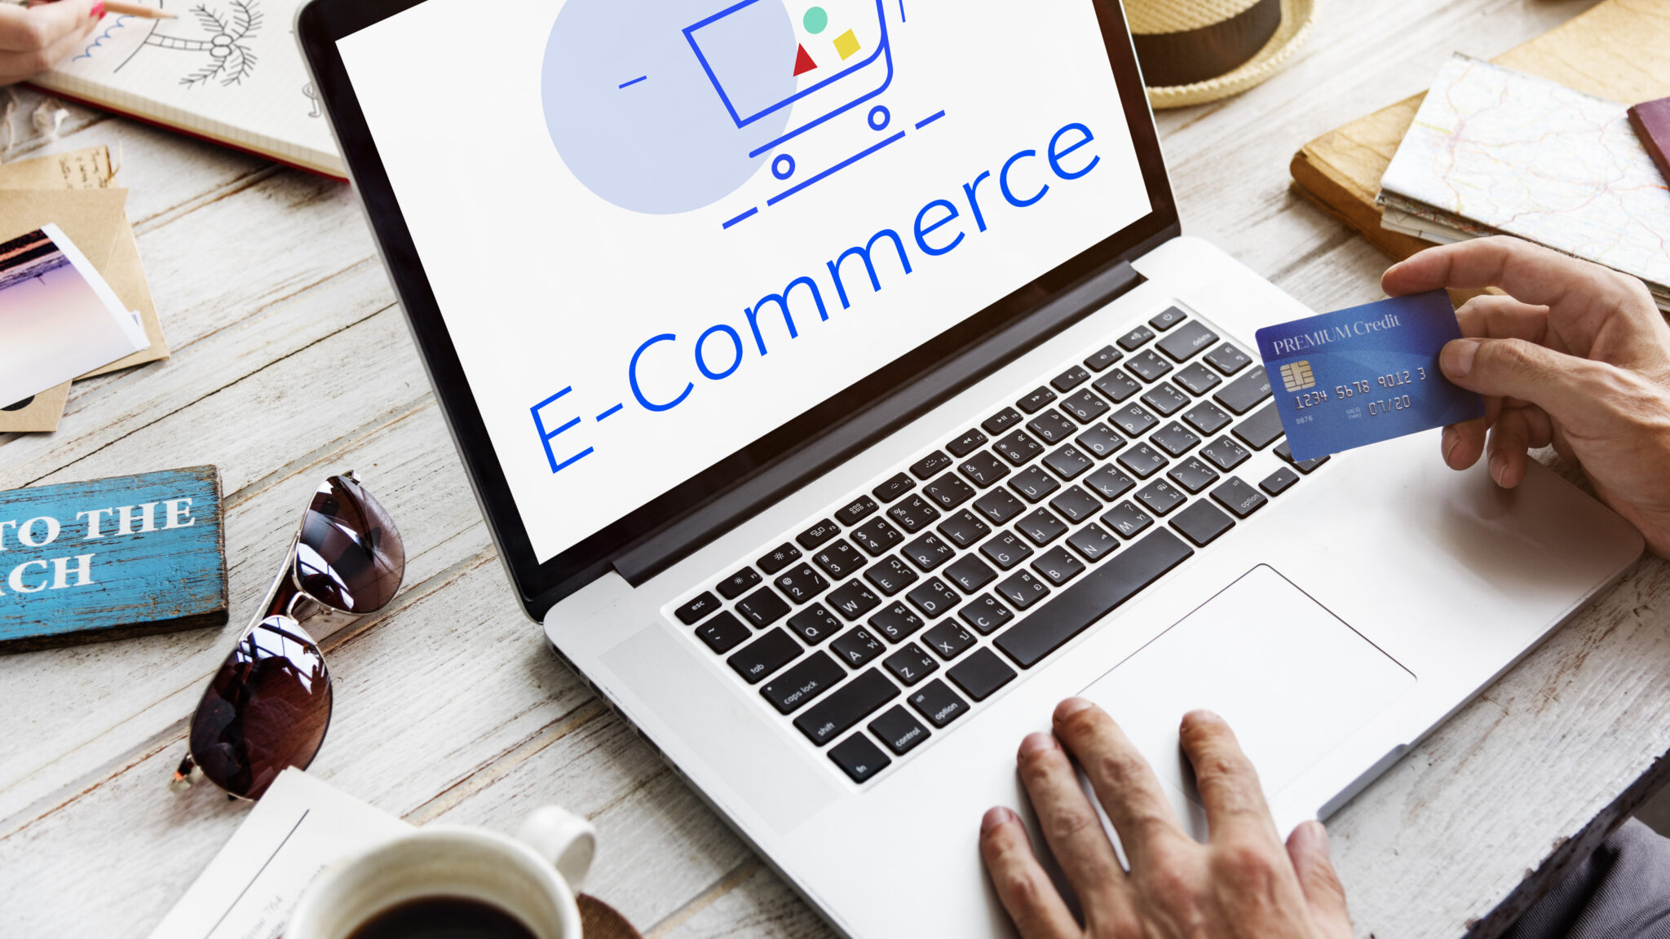

Slide 2
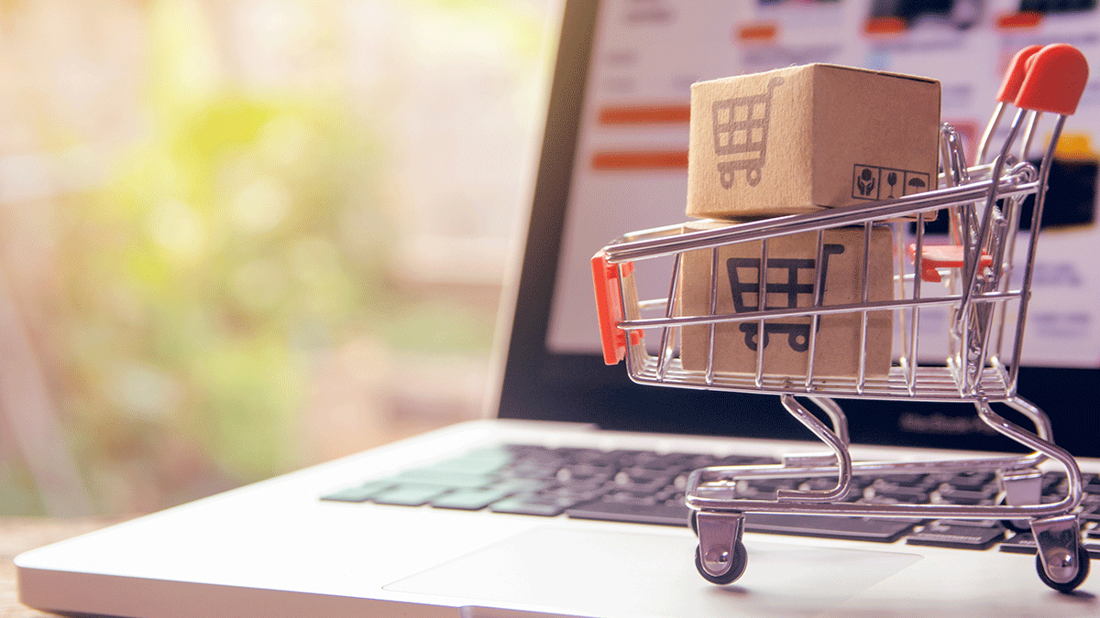
Space Market
Java & PostgreSQL Integration
Database Course Project
Submitted by:
Tali Michaeli 206088445
Saar Avivi 207881350

Slide 3

SpaceMarket
Java project overview
The original SpaceMarket Java-based project was an application that managed e-commerce operations. The system supported basic functionality such as registration as a buyer or seller, product management, shopping cart operations and order processing. It used data structures like arrays and ArrayLists to store buyers, sellers, products, and orders during runtime. All data was lost upon program termination, as there was no persistent storage.
Database overview
The system uses a PostgreSQL relational database to persist all user, product, and transaction data. It includes tables for users (storing account information such as username, password, and role), products (listing items offered by sellers), shopping carts (for managing the buyer's cart), orders (to track purchases) and reviews (for product ratings and buyer feedback).

Slide 4


Slide 5
Why was a database added?
Avoid storing the same buyer, product, or order details in multiple files.
Ensure that product prices, inventory, and user info are always up-to-date across all components.
Allow buyers and sellers to quickly search, sort, and retrieve data (past orders, cart items).
Integrate all users, products, carts, and orders in a centralized system instead of scattered files.
Ensure relationships between users, products, and orders are valid using constraints like foreign keys.
Guarantee that an order is either fully placed or not placed at all - never in an incomplete state.
Allow multiple buyers to place orders at the same time without corrupting product stock or order history.
Restrict actions like deleting users or modifying inventory to authorized roles (admin, seller).

Slide 6
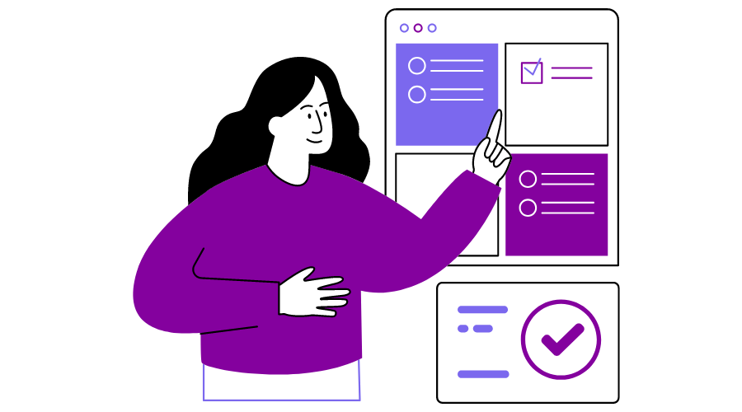
Users of the system

Slide 7
User Types
Buyer:
Represented as a user who buys products.
Has a Shopping Cart that contains multiple products.
Can place Orders and leave Reviews on products.
Seller:
Represented as a user who sells products.
Each product is assigned to a seller who controls its details and inventory.
Admin:
Manages users and monitors activity.

Slide 8

Entities and relationships

Slide 9
User:
Represents a person using the system. A user can register either as a buyer or a seller, based on their role.
Product:
Represents an item offered for sale by a seller. Each product is linked to one seller and can be part of multiple carts or orders.
Shopping Cart:
Represents a temporary list of products selected by a buyer before making a purchase.
Order:
Represents a confirmed purchase made by a buyer. Orders contain product details and are used to track purchase history.
Review:
Represents feedback provided by a buyer or seller about a product. Each review is linked to a buyer or seller and a product.
Entities

Slide 10
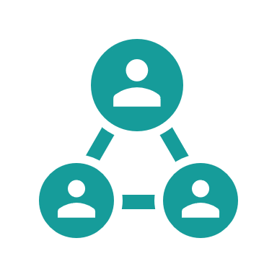
Relationships
User – Product
Relationship: sells
Each seller (a user with the role "Seller") can manage multiple products.
Each product is owned by one seller.
Cardinality: One-to-Many (1:N)
Relationship: buys
Each buyer (a user with the role “Buyer") can buy multiple products.
Each product can be purchased by many users.
Cardinality: Many-to-Many (M:N)
Order – Product
Relationship: contains
Each order contains multiple products.
Each product can appear in many orders.
Cardinality: Many-to-Many (M:N)

Slide 11
Relationships
ShoppingCart – Product
Relationship: contains
A shopping cart can contain multiple products.
A product can appear in multiple shopping carts.
Includes a quantity field per item.
Cardinality: Many-to-Many (M:N)
Product & User – Review
Each review is linked to both a product and the user who wrote it.
Cardinality:
User → Review: 1:N
Product → Review: 1:N

Slide 12
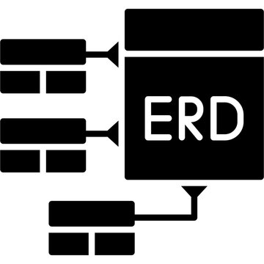

Slide 13
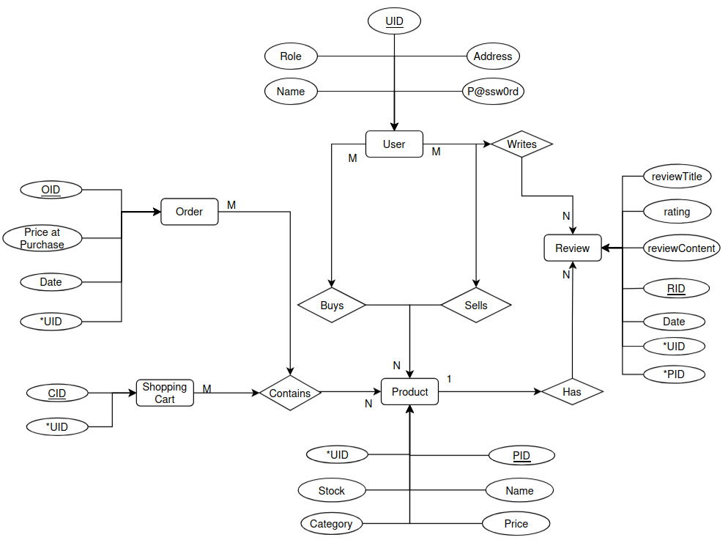

Slide 14

The Tables

Slide 15
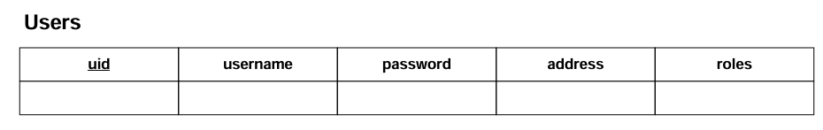
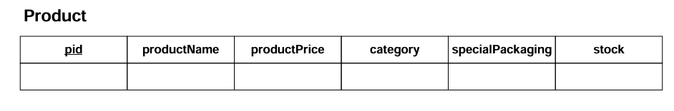
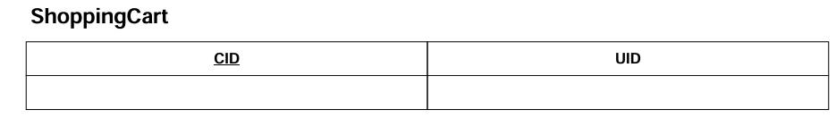
The Tables
*
*References User

Slide 16
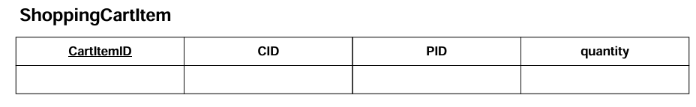
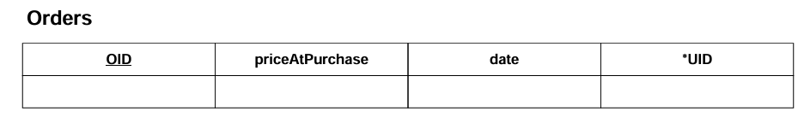
The Tables
*
*
*
*References ShoppingCart
** References Product
*References User

Slide 17
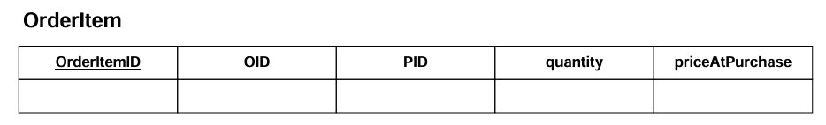
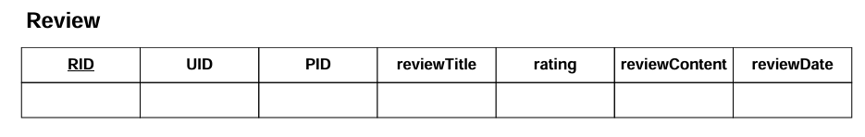
The Tables
*
*
*
*References Order
** References Product
*
*
*
*References User
** References Product

Slide 18


Slide 19
Triggers
CREATE OR REPLACE FUNCTION prevent_product_deletion_if_in_cart()
RETURNS TRIGGER AS $$
BEGIN
IF EXISTS (
SELECT 1 FROM ShoppingCartItem
WHERE pid = OLD.pid
)THEN
RAISE EXCEPTION 'Cannot delete product %: it exists in a cart.', OLD.pid;
END IF;
RETURN OLD;
END;
$$ LANGUAGE plpgsql;

Slide 20
Triggers
CREATE TRIGGER trg_prevent_product_deletion
BEFORE DELETE ON Product
FOR EACH ROW
EXECUTE FUNCTION prevent_product_deletion_if_in_cart();

